Slide 1
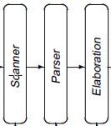
Construct Scanners
source
code
Front End
IR
Optimizer
IR
Back End
target
code
Last Lecture: NFA DFA
Today: NFA minimized DFA -> Scanner
Subset construction
DFA
Hopcroft’s algorithm
Brzozowski’s algorithm

Slide 2
Example
a ( b | c )*
ε
ε
S₄
b
S₅
ε
S₀
a
S₁
ε
S₂
ε
S₃
S₈
ε
S₉
Thompson’s Construction
ε
S₆
c
S₇
ε
ε
b
d₂
b
d₀
a
d₁
b
c
Subset Construction
c
d₃
c

Slide 3
The Plan for Scanner Construction
✓
RE → NFA (Thompson’s construction)
Build a nondeterministic finite automaton (NFA) for each term in the RE
Combine them in patterns that model the operators
NFA → Minimal DFA
Option1: NFA → DFA→ Minimal DFA
NFA → DFA: Subset construction to build a DFA that simulates the NFA
DFA → Minimal DFA: Hopcroft’s algorithm
Option2: NFA → Minimal DFA
Brzozowski’s algorithm
DFA → RE (not really part of scanner construction)
All pairs, all paths problem
Union together paths from s₀ to a final state
✓
The Cycle of Constructions
minimal DFA
RE
NFA
DFA
Taken together, these constructions prove that DFAs and REs are equivalent.

Slide 4
DFA Minimization: Hopcroft’s Algorithm
The Big Picture
iteratively constructs partitions of the DFA’s states
Discover sets of equivalent states in the DFA
Two new states are equivalent if and only if:
The set of paths leading to them are equivalent, and
∀ α ∈ Σ, transitions on α lead to equivalent new states (DFA)
Any new state that has α-transitions to distinct sets must be split
Represent each such set with a single new state
A partition P of S: A collection of sets P s.t. each s ∈ S is in exactly one p_{i} ∈ P

Slide 5
DFA Minimization : Hopcroft’s Algorithm
Details of the algorithm
Group states into maximally sized initial sets, optimistically
Iteratively subdivide those sets, based on transition graph
States that remain grouped together are equivalent
Initial partition, P₀ , has two sets: { A } & { D-A }
Splitting a set (“partitioning a set by a”)
Assume s_{a} & s_{b} ∈ p_{i} , and δ(s_{a},a) = s_{x} , & δ(s_{b},a) = s_{y}
If s_{x} & s_{y} are not in the same set p_{j}, then p_{i} must be split
s_{a} has transition on a, s_{b} does not ⇒ a splits p_{i}
A single state in a DFA cannot have two transitions on a
p_{j}
p_{i}
Accepting
states
other
states
a
s_{a}
s_{x}
p_{k}
a
s_{y}
s_{b}
Notes:
Digress for a moment on the meaning of “optimistic”
Optimistic, in this case, means the assumption that would lead to the smallest DFA
— that is, grouping together as many states as possible.
The algorithm assumes, optimistically, that is has final and non-final states and then refines that partition — splits sets so that each set holds a smaller number of states— based on the principle that the set must have a single transition on each letter alpha in the alphabet. This latter point is equivalent to saying the minimal DFA must be a DFA!

Slide 6
DFA Minimization Algorithm : Hopcroft’s Algorithm
T ← {A, { D − A} };
P ← Ø
while (P != T) do
P ← T;
T ← Ø;
for each set p ∈ P do
T ← T ∪ Split(p);
end;
end;
Split(S) {
for each c ∈ ∑ do
if c splits S into s1 and s2
then return {s1, s2 };
end;
return S;
}
Notes:
This worklist algorithm splits sets in the partition by working backward along edges in the transition graph.
Given a set S in the current partition (named, oddly, Partition), it first finds all of the states that can reach
S via a given character (c) — the set of states that can reach S via c is called the Projection into S via c.
Next, it intersects the Projection with each set p in Partition to discover two things:
Can any state in p reach S via a transition labelled c?
If so, are there any states in p that reach some other point on a transition labelled c?
If the answer to both of these questions is “yes”, then the algorithm must split p around
the transitions into S on c.
The code at the bottom simply updates the worklist.

Slide 7
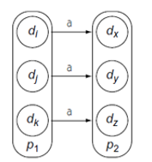
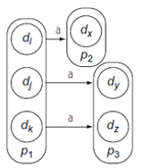
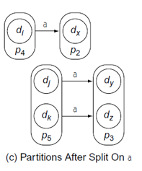
Splitting a Partition around a

Slide 8
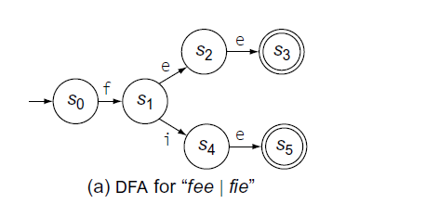
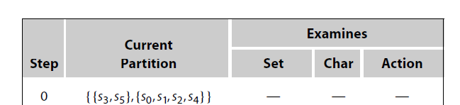
A Detailed Example

Slide 9
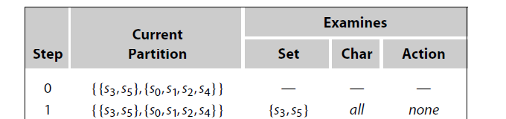

A Detailed Example

Slide 10
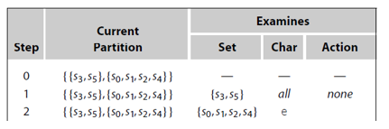
A Detailed Example

Slide 11
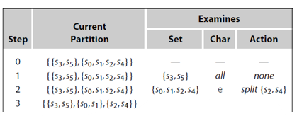
A Detailed Example

Slide 12
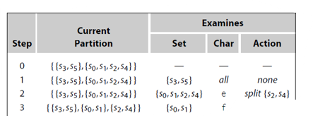
A Detailed Example

Slide 13
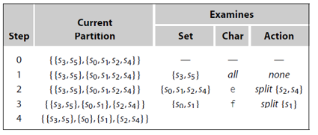
A Detailed Example
S₀ has transition on f but s₁ doesn’t

Slide 14
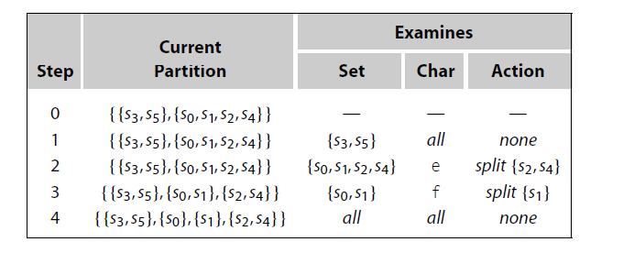
A Detailed Example

Slide 15

A Detailed Example

Slide 16

Another example
ε
a ( b | c )* : Thompson’s algorithm
ε
S₄
b
S₅
ε
S₀
a
S₁
ε
S₂
ε
S₃
S₈
ε
S₉
ε
S₆
c
S₇
ε
The DFA for a ( b | c )*: subset construction
ε
b
d₂
b
DFA Minimization: Hopcroft Algorithm
a
d₀
d₁
b
c
c
d₃
c
b | c
s₀
a
s₁

Slide 17
Another example
a
a
DFA for ( a | b )* abb
Minimization
s₀
a
s₁
b
s₃
b
s₄
b
a
a
b
s₂
b
{s₄} {s₀,s₁,s₂,s₃}
{s₄}
all
none
b
a
a
{s₄} {s₀,s₁,s₂,s₃}
{s₀,s₁,s₂,s₃}
b
split s₃
s₀ , s₂
a
s₁
b
s₃
b
s₄
{s₄} {s₃} {s₀,s₁,s₂}
{s₀,s₁,s₂}
a
none
a
b
{s₄} {s₃} {s₀,s₁,s₂}
{s₀,s₁,s₂}
b
split s₁
{s₄} {s₃} {s₁} {s₀,s₂}
{s₀,s₂}
all
none

Slide 18
The Plan for Scanner Construction
✓
RE → NFA (Thompson’s construction)
Build a nondeterministic finite automaton (NFA) for each term in the RE
Combine them in patterns that model the operators
NFA → Minimal DFA
Option1: NFA → DFA→ Minimal DFA
NFA → DFA: Subset construction to build a DFA that simulates the NFA
DFA → Minimal DFA: Hopcroft’s algorithm
Option2: NFA → Minimal DFA
Brzozowski’s algorithm
DFA → RE
All pairs, all paths problem
Union together paths from s₀ to a final state
✓
✓
The Cycle of Constructions
minimal DFA
RE
NFA
DFA
Taken together, these constructions prove that DFAs and REs are equivalent.

Slide 19
Brzozowski’s Algorithm for DFA Minimization
a
ε
b
ε
c
NFA for abc | bc | ad:
s₁
s₂
s₃
s₄
ε
ε
b
ε
c
ε
Thompson’s construction would leave ε-transitions between each single-character automaton
s₀
s₅
s₆
s₇
ε
ε
ε
d
ε
s₁₁
s₈
a
s₉
s₁₀
NFA -> DFA: subset construction
The Intuition
The subset construction merges prefixes in the NFA.
Can apply subset construction again to remove duplicate tails.
s₆
d
Subset construction eliminates ε-transitions and merges the paths for a.
It leaves duplicate tails, such as bc, intact
s₁
b
s₂
c
s₃
a
s₀
b
s₄
c
s₅

